Slide 1
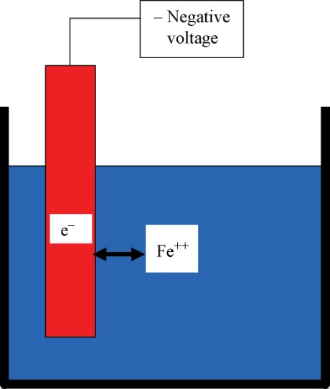
FIGURE 31.1 Corrosion from a Single Iron or Steel Electrode in Water
Copyright © 2016 Elsevier Ltd. All rights reserved.

Slide 2
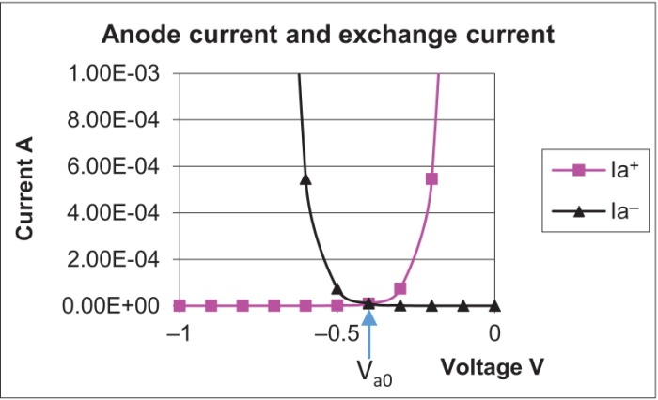
FIGURE 31.2 Anode Currents
Copyright © 2016 Elsevier Ltd. All rights reserved.

Slide 3
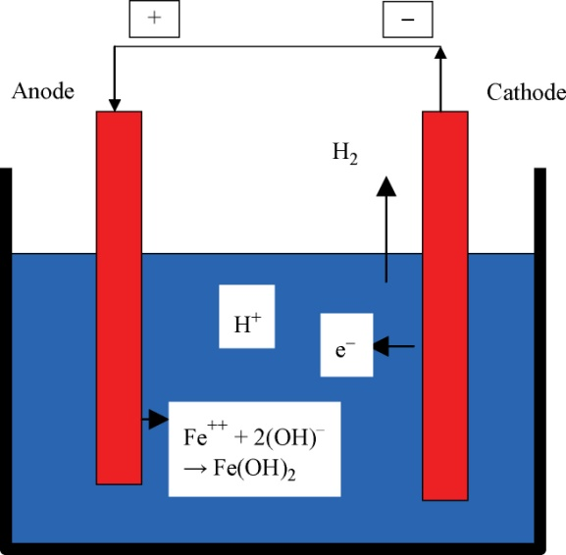
FIGURE 31.3 Slow Corrosion in Pure Water
Copyright © 2016 Elsevier Ltd. All rights reserved.

Slide 4
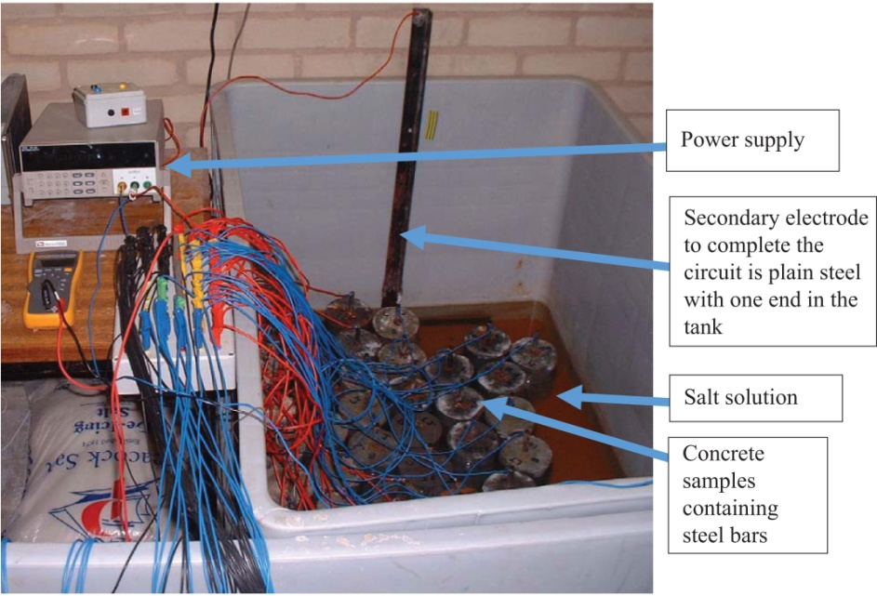
FIGURE 31.5 Corrosion Samples with Applied Voltage
Copyright © 2016 Elsevier Ltd. All rights reserved.

Slide 5
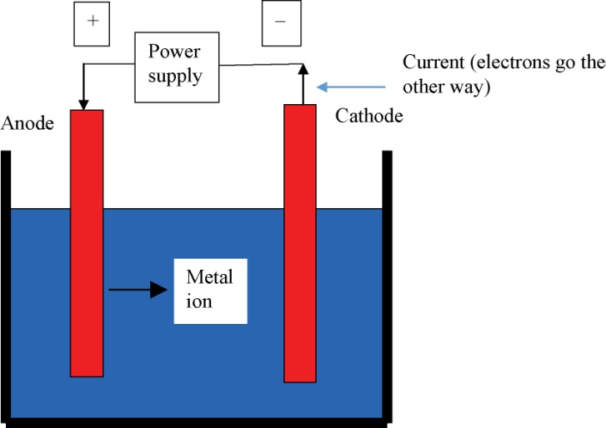
FIGURE 31.4 Corrosion Caused by Applied Voltage
Copyright © 2016 Elsevier Ltd. All rights reserved.

Slide 6
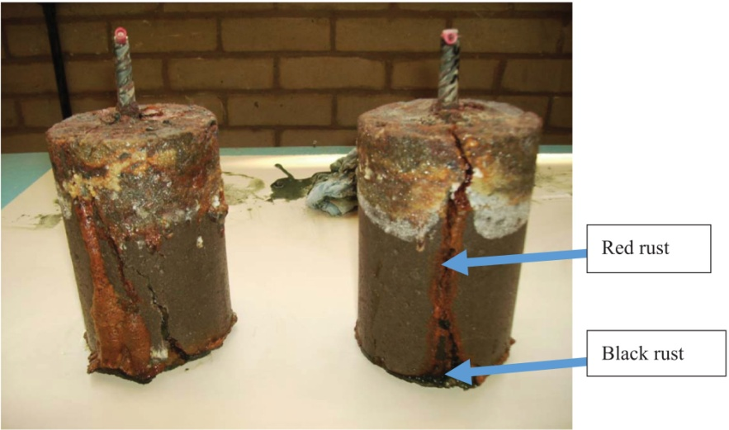
FIGURE 31.6 Corrosion Samples After Just 2 Months at +100 mV
Copyright © 2016 Elsevier Ltd. All rights reserved.

Slide 7
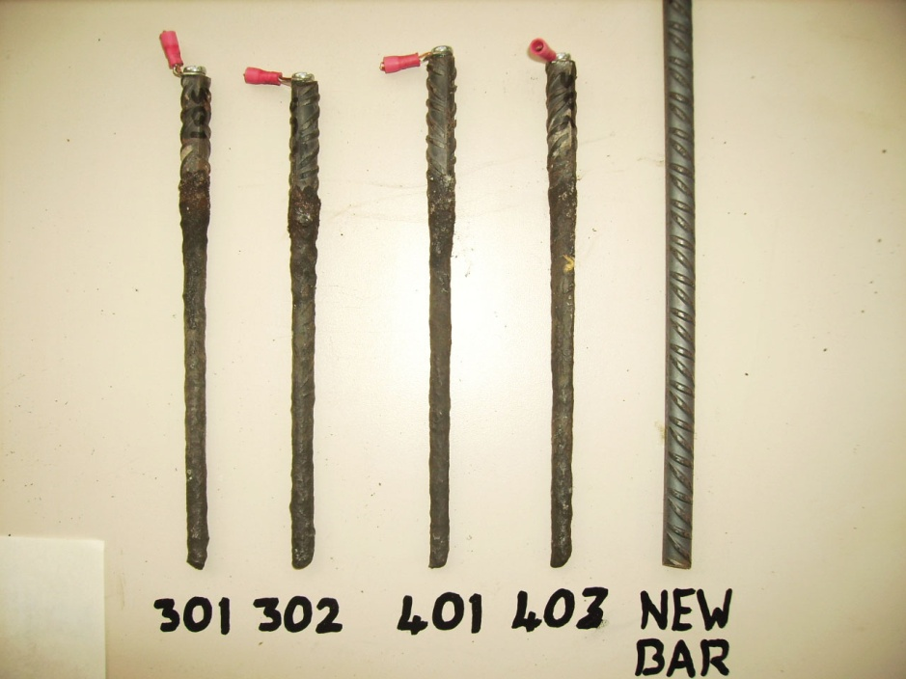
FIGURE 31.7 Steel Bars Extracted from Corrosion Samples in Figure 31.6
Copyright © 2016 Elsevier Ltd. All rights reserved.

Slide 8
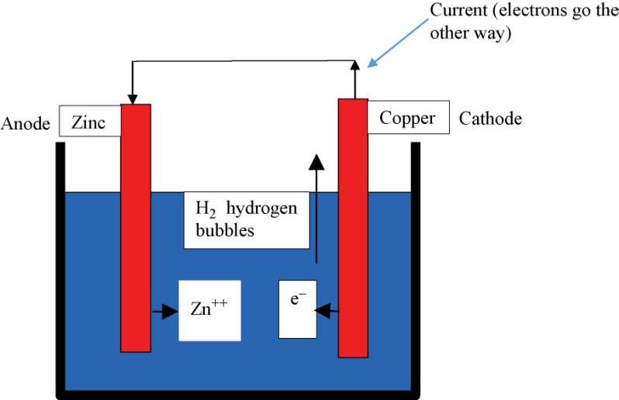
FIGURE 31.8 Corrosion of Dissimilar Metals
Copyright © 2016 Elsevier Ltd. All rights reserved.

Slide 9
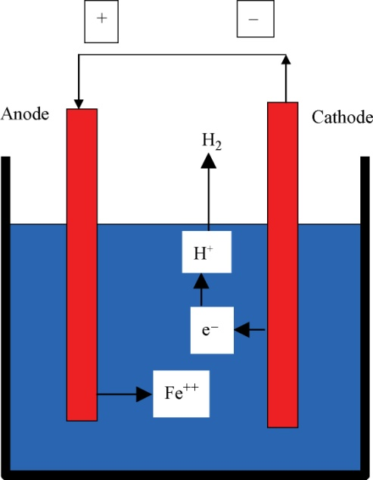
FIGURE 31.9 Acid Attack on Metal
Copyright © 2016 Elsevier Ltd. All rights reserved.

Slide 10
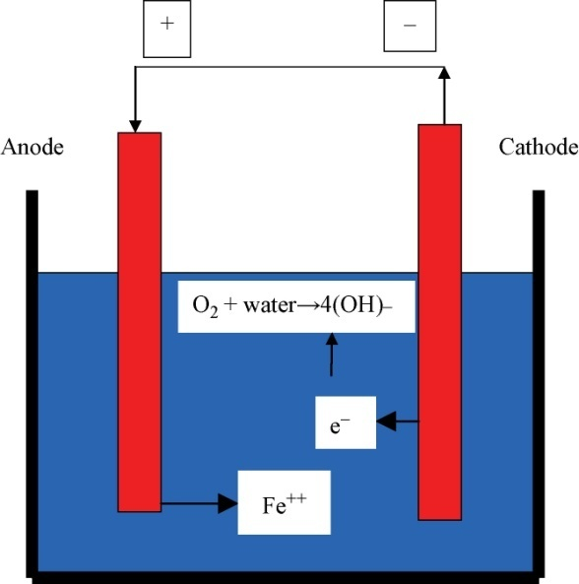
FIGURE 31.10 Corrosion with Oxygen
Copyright © 2016 Elsevier Ltd. All rights reserved.

Slide 11
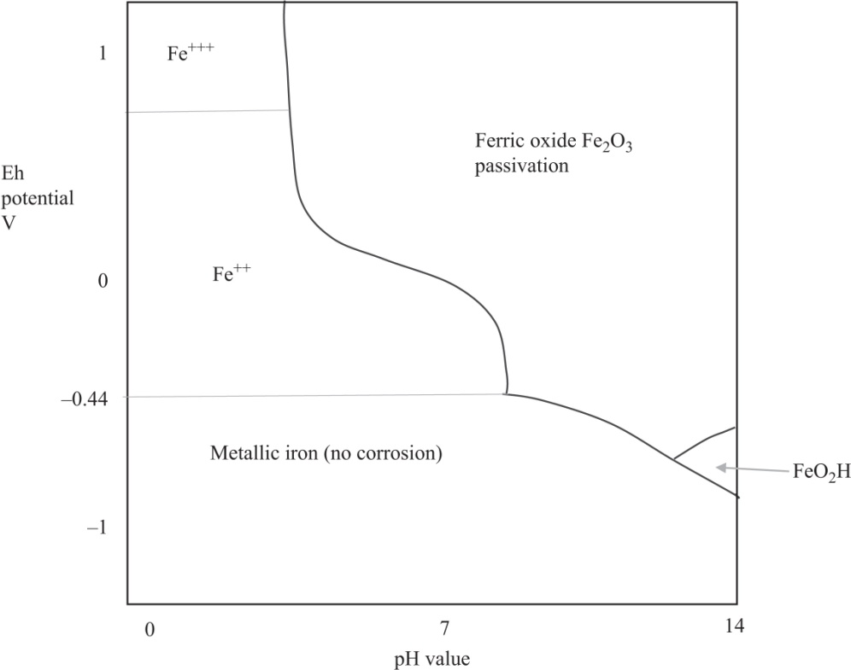
FIGURE 31.11 Pourbaix Diagram for Iron
Copyright © 2016 Elsevier Ltd. All rights reserved.

Slide 12
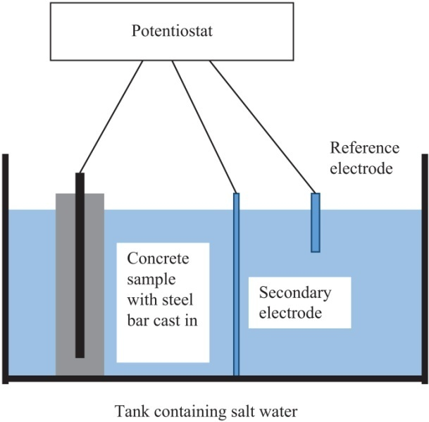
FIGURE 31.12 Diagram of Corrosion Experiment
Copyright © 2016 Elsevier Ltd. All rights reserved.

Slide 13
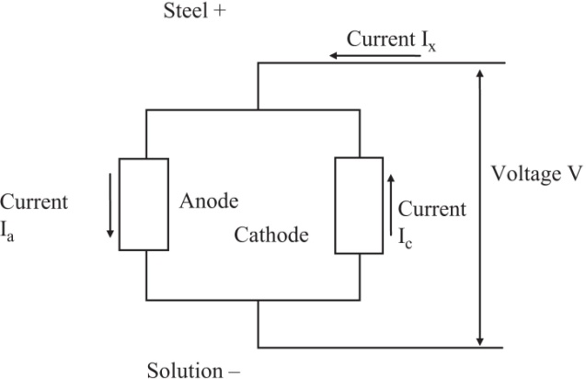
FIGURE 31.13 Schematic Equivalent Circuit for Steel in Solution
Copyright © 2016 Elsevier Ltd. All rights reserved.

Slide 14
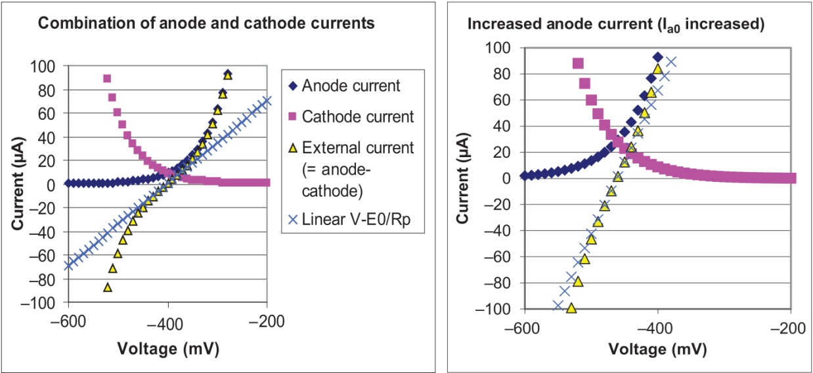
FIGURE 31.14 (a) Left and (b) Right
Copyright © 2016 Elsevier Ltd. All rights reserved.

Slide 15
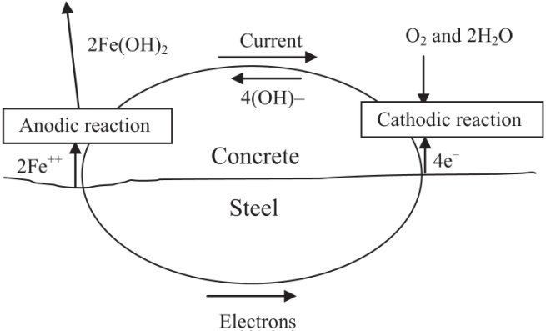
FIGURE 31.15 Corrosion of Steel in Concrete
Copyright © 2016 Elsevier Ltd. All rights reserved.

Slide 16
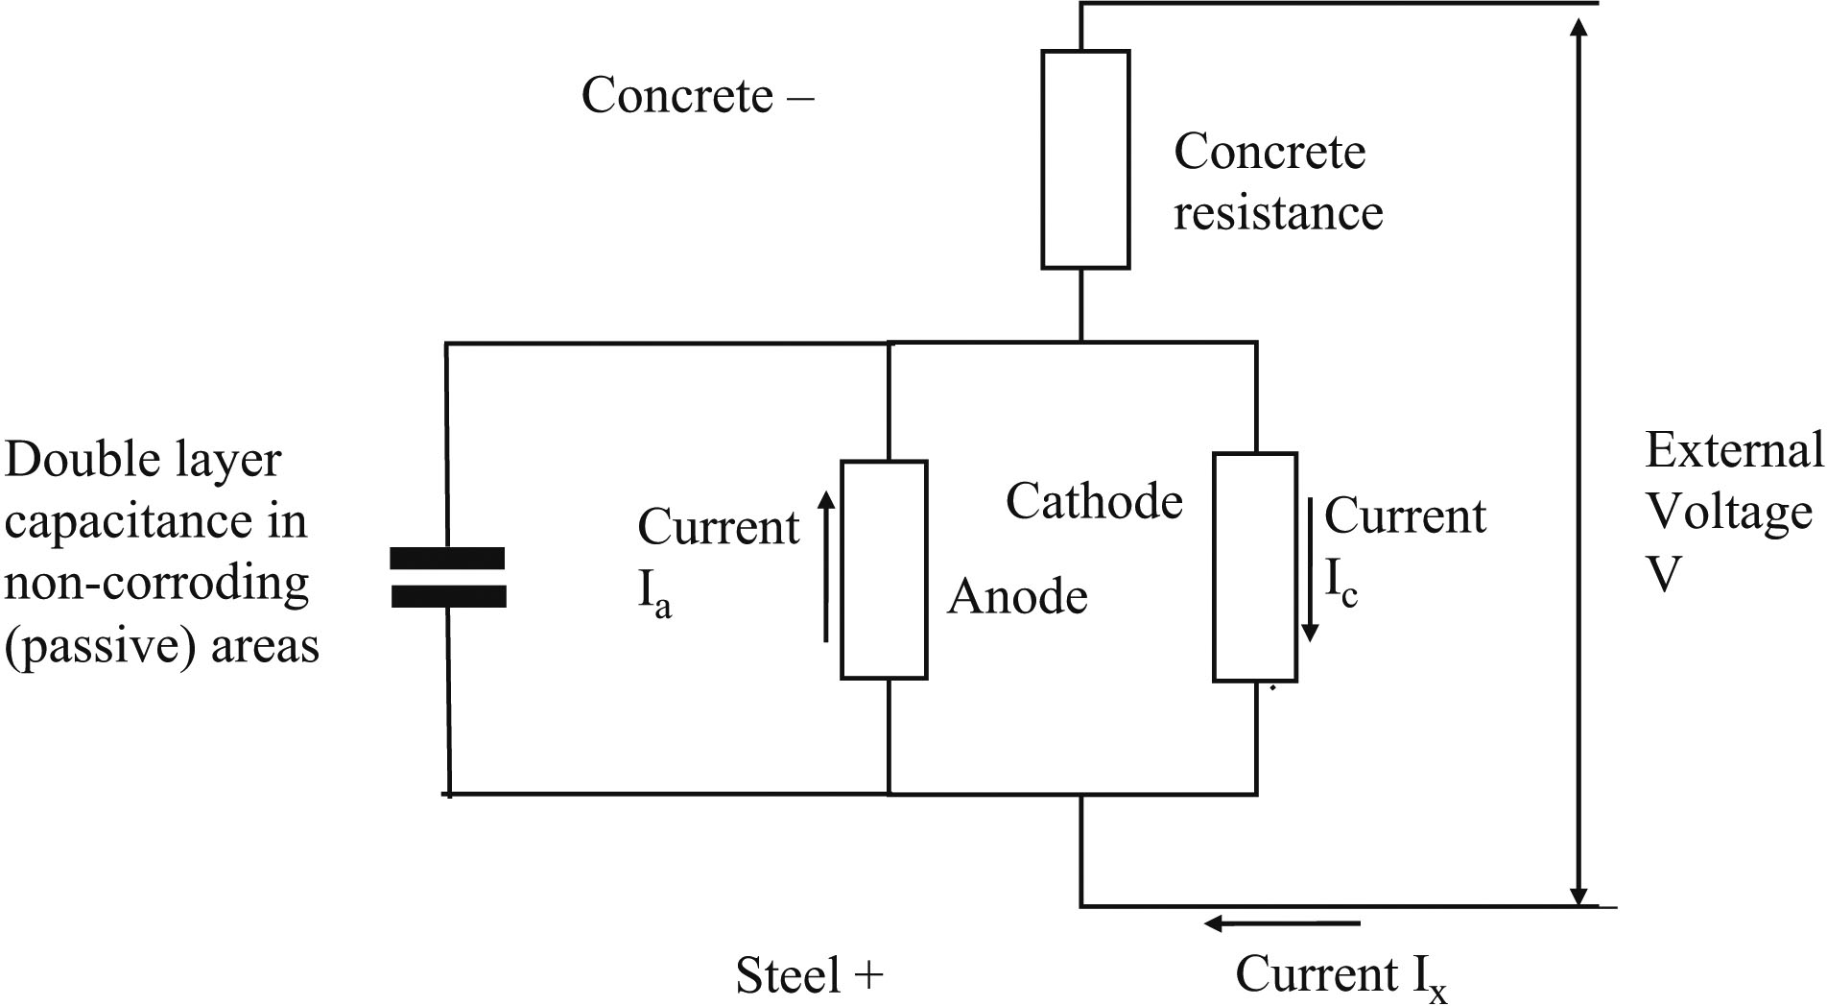
FIGURE 31.16 Equivalent Circuit Diagram of Steel Corrosion in Concrete
Copyright © 2016 Elsevier Ltd. All rights reserved.

Slide 17
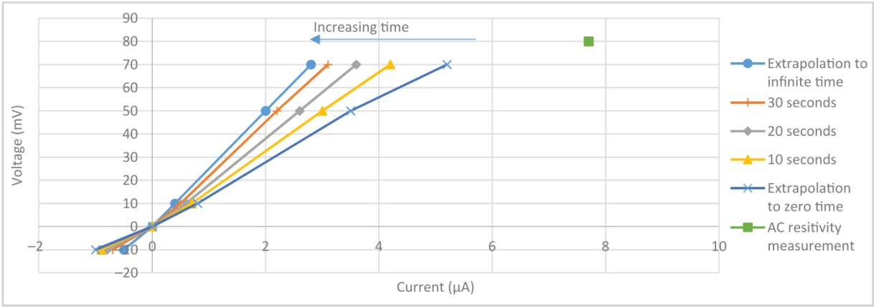
FIGURE 31.17 Laboratory Data for Linear Polarisation
Copyright © 2016 Elsevier Ltd. All rights reserved.

Slide 18
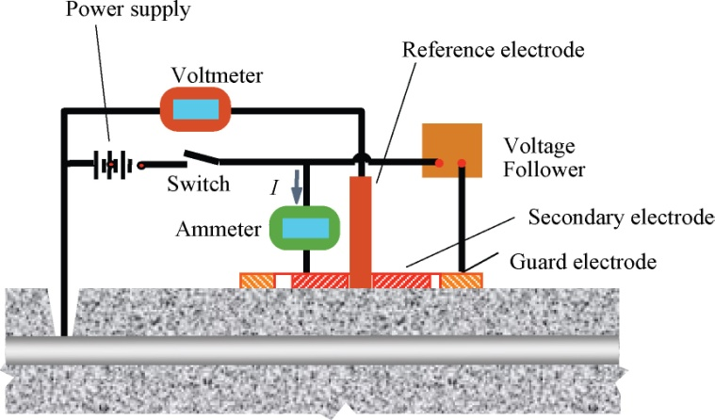
FIGURE 31.18 Linear Polarisation with Guard Electrode
Copyright © 2016 Elsevier Ltd. All rights reserved.

Slide 19
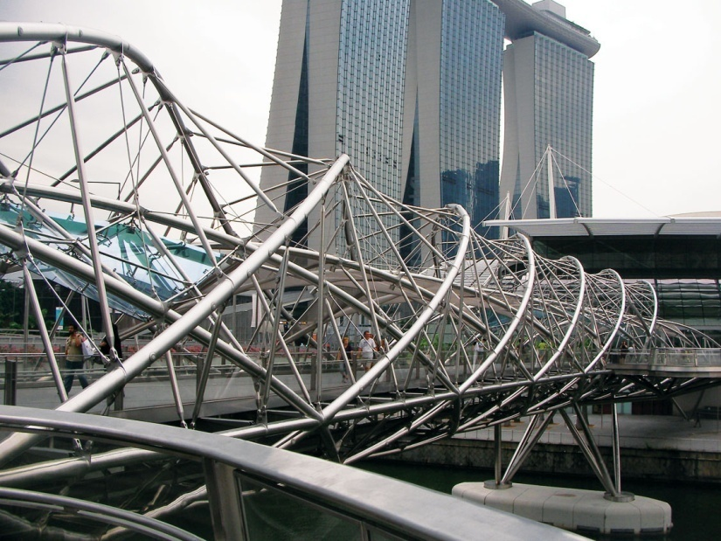
FIGURE 31.19 This Bridge in Singapore has been Constructed Entirely out of Stainless Steel
Copyright © 2016 Elsevier Ltd. All rights reserved.

Slide 20
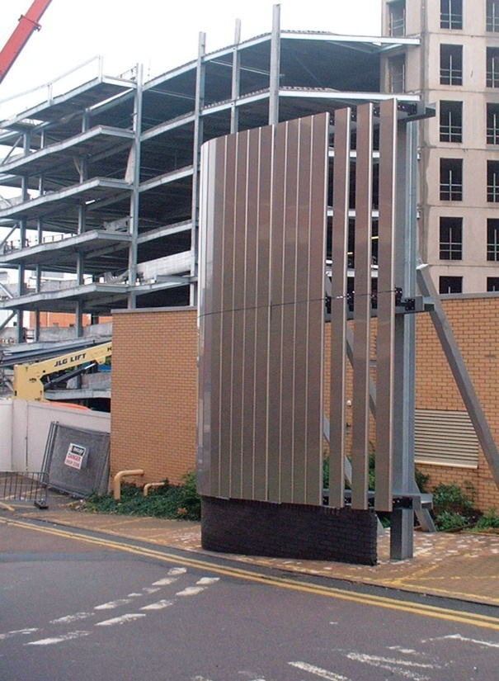
FIGURE 31.20 A Sample Panel of Stainless Steel Cladding Panels for use on the Car Park Behind that is Under
Construction
Copyright © 2016 Elsevier Ltd. All rights reserved.

Slide 21
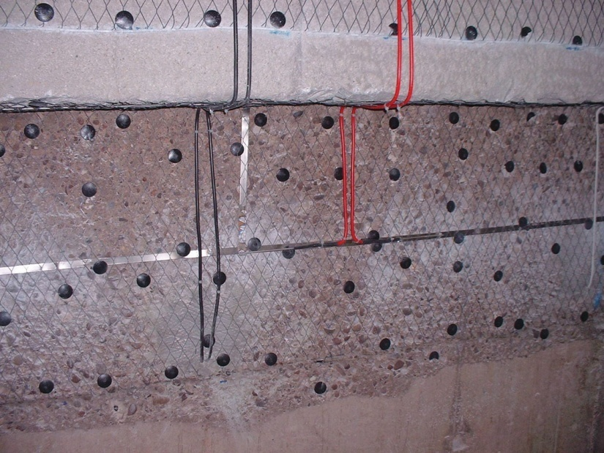
FIGURE 31.21 Titanium Mesh Anode Installed for Cathodic Protection
Copyright © 2016 Elsevier Ltd. All rights reserved.

Slide 22
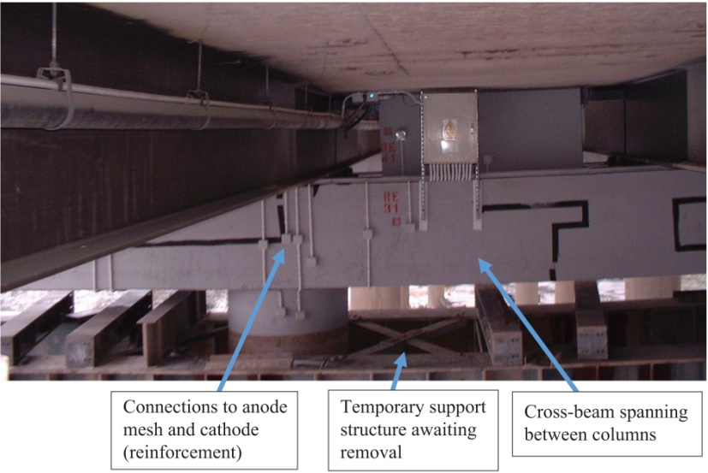
FIGURE 31.22 Completed Cathodic Protection System
Copyright © 2016 Elsevier Ltd. All rights reserved.

